Slide 1
Numerical Optimization Introduction

Slide 2
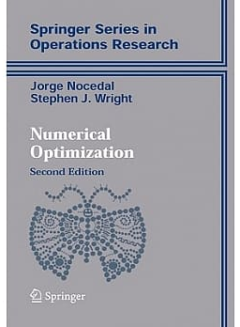

Class Information
Teacher: 李哲榮 (cherung@cs.nthu.edu.tw)
Textbooks:
Numerical Optimization, Jorge Nocedal Stephen J. Wright, 2nd edition
Deep Learning, Ian Goodfellow and Yoshua Bengio and Aaron Courville (https://www.deeplearningbook.org/ )
TA: TBA
Office hours: Friday 9-10
Website: eeclass.nthu.edu.tw

Slide 3
Grading
Participation 10%,
For class participation, everyone needs to ask/answer at least three times in different classes
Assignments 60%,
Assignments will include written part and programming part.
Written assignments are required to type in Latex.
Programming assignments will use Python Optimization (scipy.optimize) or PyTorch Optimizer (pytorch-optimizer)
Presentation 30%.
For presentation, everyone needs to read at least one research paper related to this class, present it in class. Presentation should be in Latex.

Slide 4
Tentative Schedule
Date | Topics
9/14, 9/16 | Optimization for One Variable
9/21. 9/23 | Optimization for Multi-Variables
9/29, 9/30 | Modified Newton Methods
10/5, 10/7 | Line Search and Trust Region
10/12, 10/14 | Quasi-Newton Methods and CG
10/19, 10/21 | Methods for Large Scale Training & DL Training
10/26, 10/28 | Least-Squares Problems
11/2, 11/4 | Linear Programming: The Simplex Method
11/9, 11/11 | Constrained Optimization Problems
11/16, 11/18 | Quadratic Programming & Active Set Method & SQP
11/23, 11/25 | Penalty & Augmented Lagrangian Methods
11/30, 12/2 | Interior Point Method
12/7-12/30 | Presentations

